Slide 1

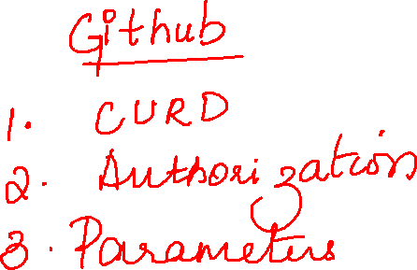

Slide 2
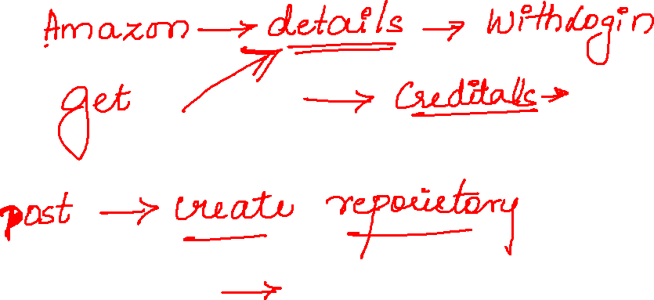

Slide 3
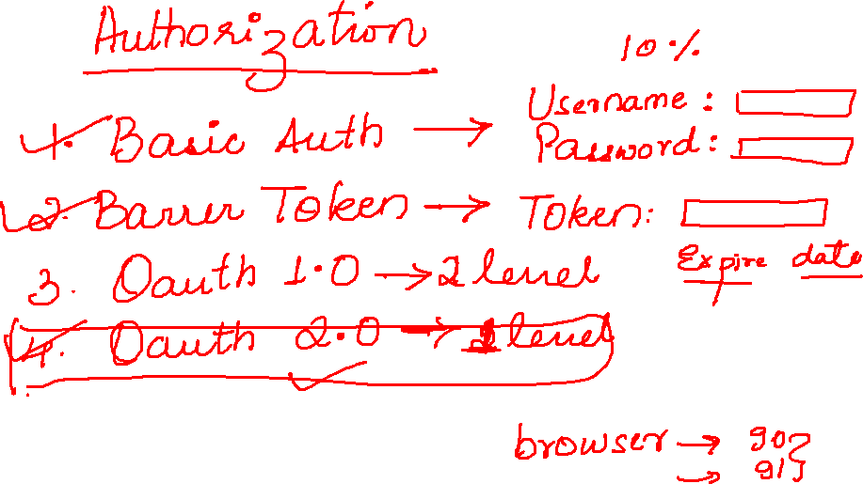

Slide 4
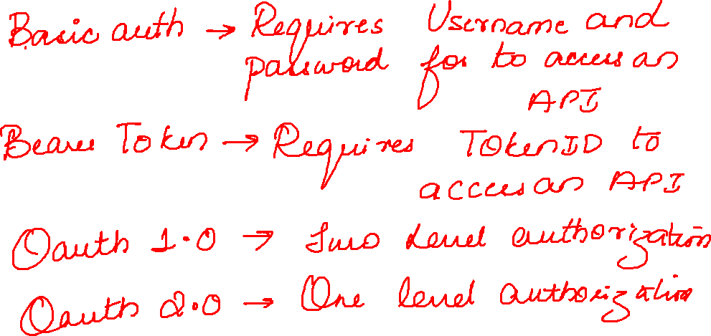

Slide 5
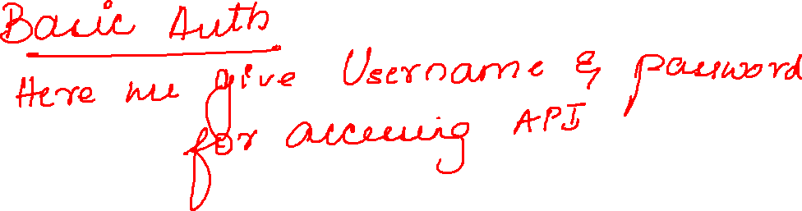

Slide 6
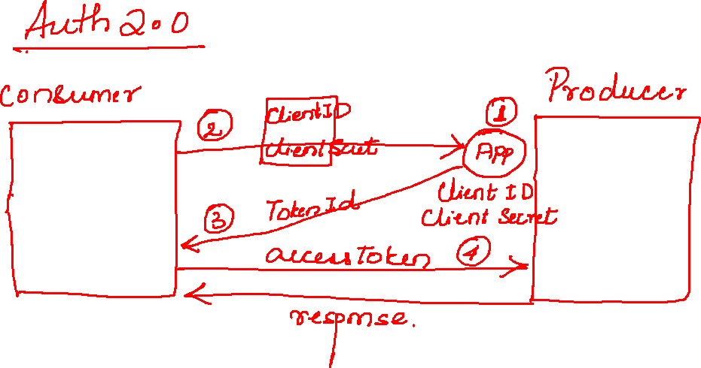

Slide 7
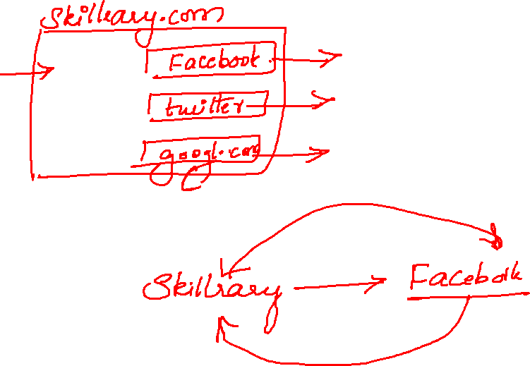

Slide 8
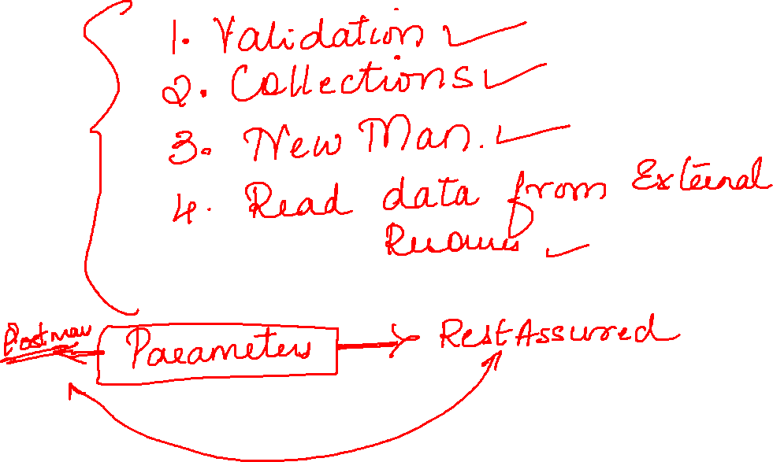

Slide 9
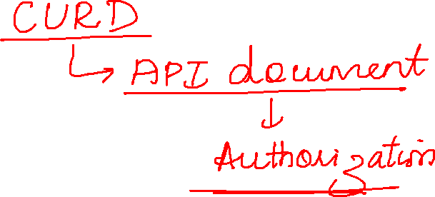

Slide 10
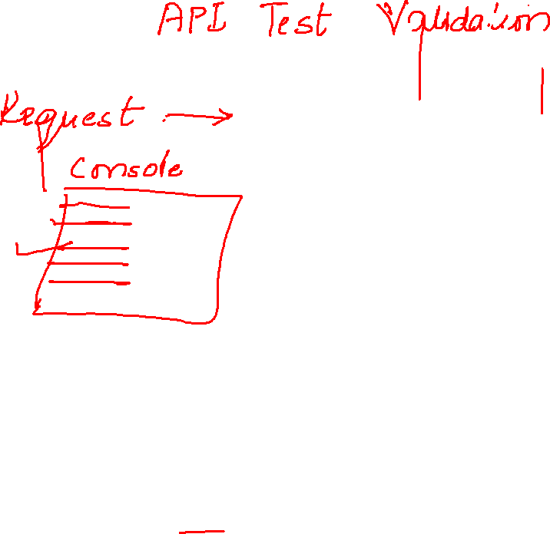

Slide 11
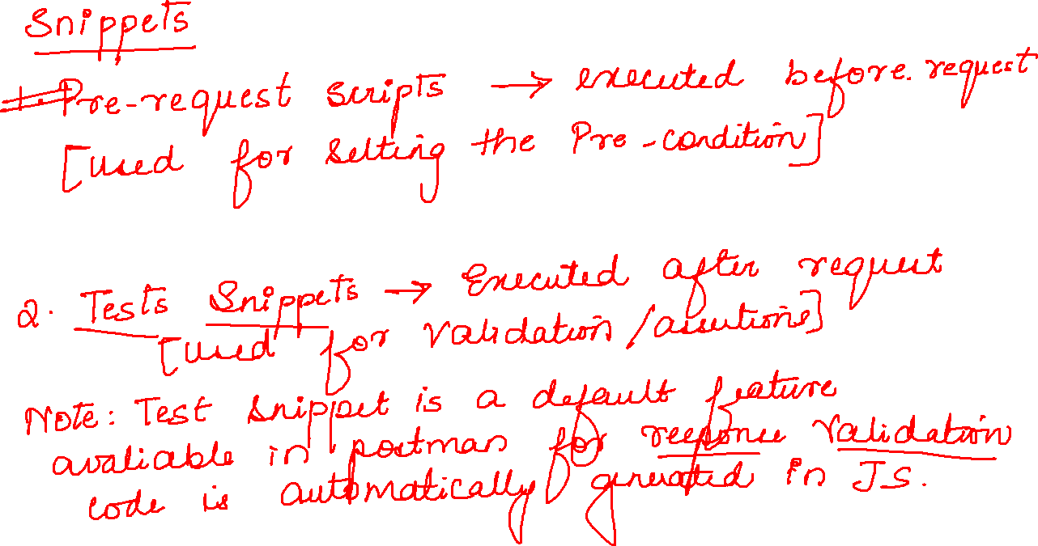

Slide 12
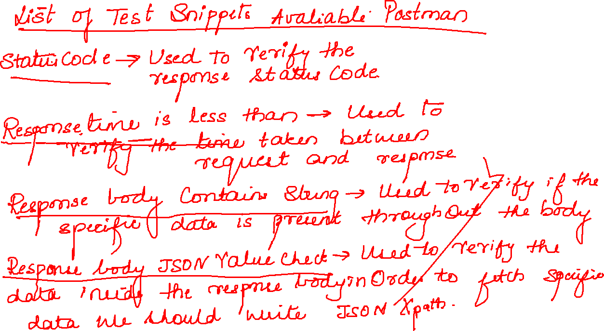

Slide 13
[ { "id": 3, "title": "pythonapi", "author": "bharani89" }, { "id": 5, "title": "Python-selenium", "author": "john" }, { "author": "Bharani", "id": 51, "title": "APItesting" }, { "author": "Bharanigr", "id": 515, "title": "Manaultesting" }, { "id": 900, "title": "qwsedrty", "author": "Bharanigramesh" }, { "id": 9000, "title": "qwsedrty", "author": "Bharanigramesh" }, { "id": 87, "title": "apitest", "author": "john", "name": "omkar" }, { "id": 9087, "title": "apiweekend124" }, { "id": 10000, "title": "api", "author": "Om", "firstname": "Divya", "lastname": "OP" }, { "id": "234", "title": "qwerty6" }, { "id": 40009, "title": "demoapitestingus" } ]

Slide 14
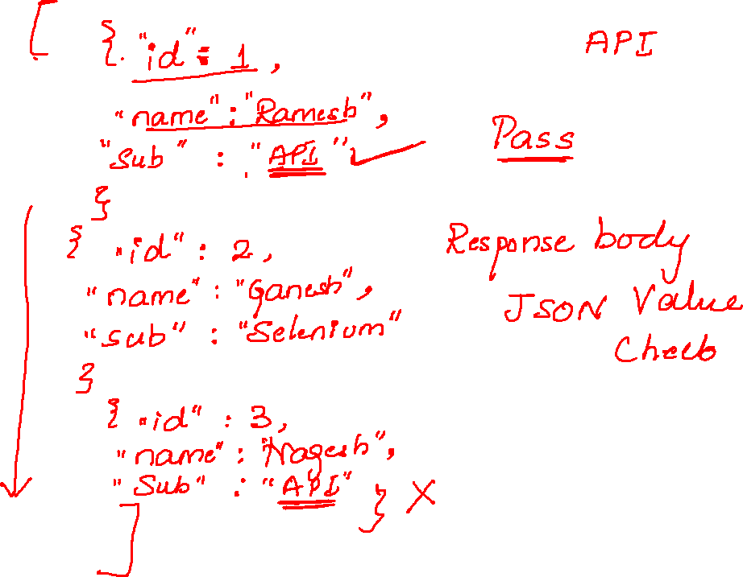

Slide 15
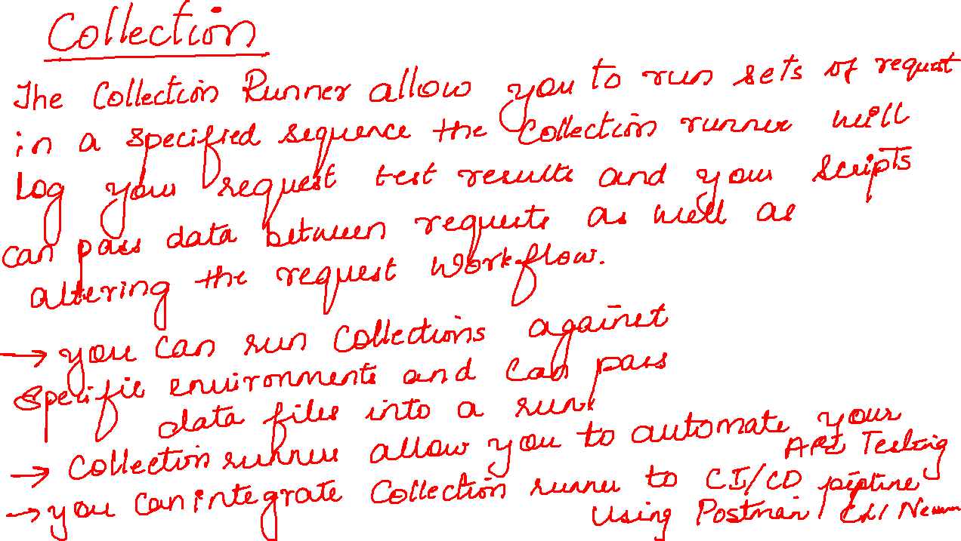

Slide 16
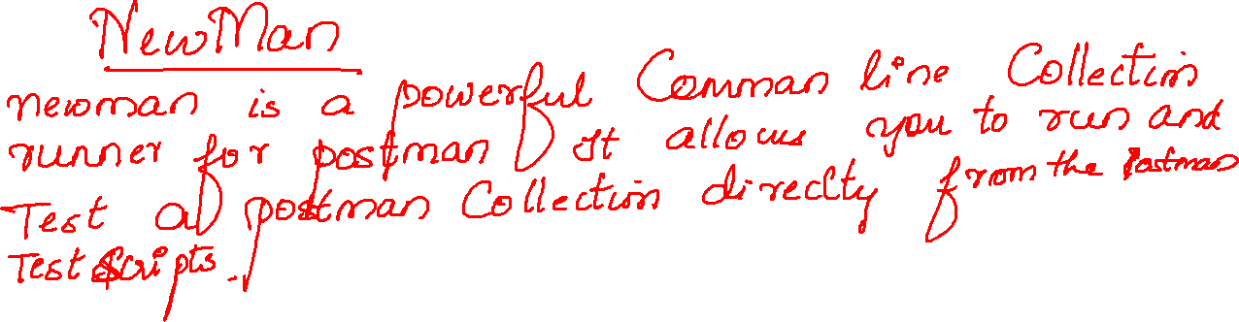

Slide 17
